Slide 1

CMSE 202 Final Project Presentation
By: Abdulla A, Aaron K, Sean O, Sit S

Slide 2
Our GitHub Repo:
https://github.com/soesit/CMSE202_Project

Slide 3
Research Question
Can we accurately predict GPA using machine learning?
Our GitHub repo:
https://github.com/soesit/CMSE202_Project

Slide 4
Data
Based on first-year college student GPAs
Binary/Dummy Variables
Strong correlators:
HSGPA and GPA
GPA and HU

Slide 5
Methodology
OLS Regression: used to understand the relationship between one or more ind. Variables and a dep.
Statistically insignificant on multiple levels
First Gen coefficient = -0.09
All others positive
Low r-squared
Heatmaps and Regression Plots
Randomly distributed residuals
Scattered and weak
SVM model hyper tuned by GridSearch
Pervious model parameters: (C = 1, kernel = linear, Gamma = 1/n_features)
New model parameters: (C = 1, kernel = linear, Gamma = 0.005)

Slide 6
OLS regression
We first made an OLS regression with all features using statsmodels.api
We then made a correlation heatmap and removed redundant features
Plotted results using plot_regress_exog
Only slight improvement from reducing features

Slide 7
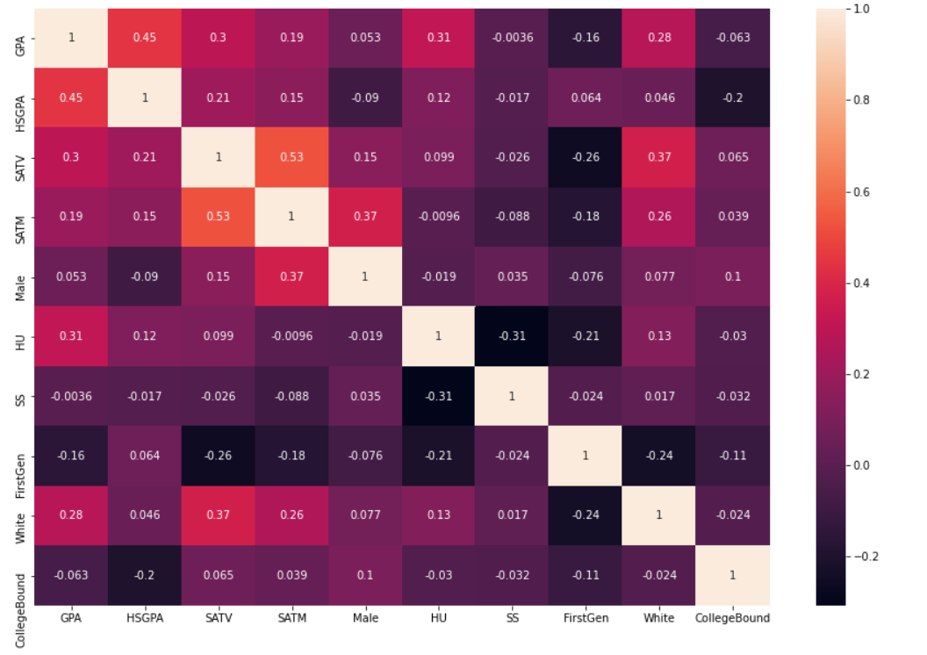
Seaborn Heatmap

Slide 8
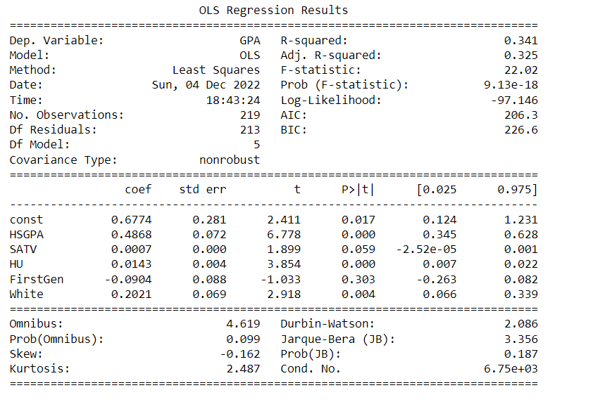
OLS Regression results
R-squared values are all low
Only a few relationships are statistically significant
Most significant is high school GPA

Slide 9
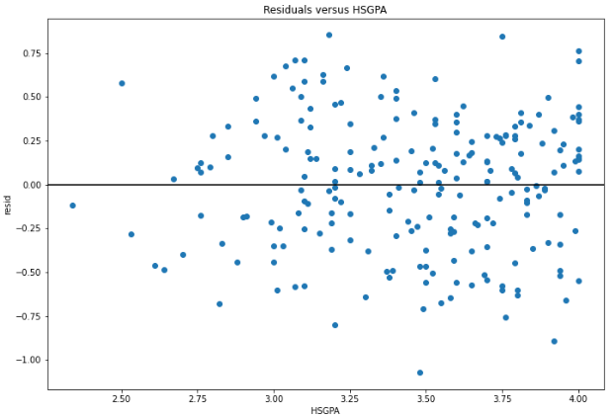
Residuals for HSGPA
Homoscedastic
(similar variance)
No distinct pattern

Slide 10
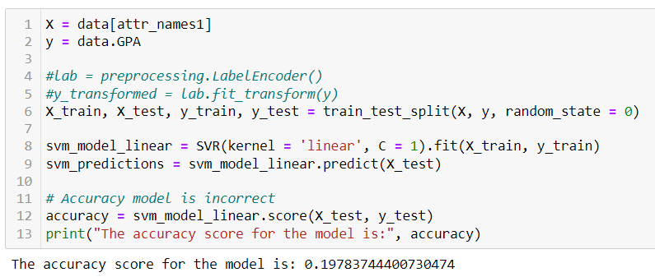
SVM Results

Slide 11
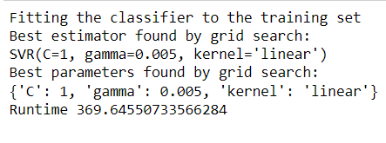
SVR GridSearch Results

Slide 12
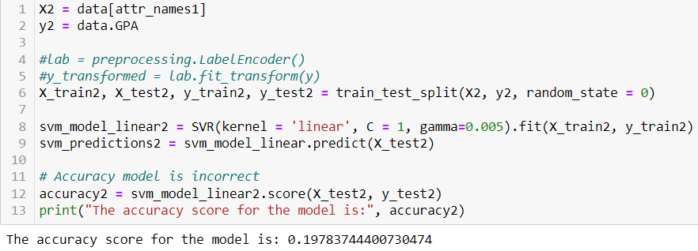
Hyper tuned SVM Results
No difference in the accuracy between our first SVM model and this one because the same parameters were used.

Slide 13
Conclusion
Our OLS models failed to find a strong correlation, but it did highlight the significant variables in our data.
Our first SVM model yielded a bad accuracy score.
In an effort to improve our SVM results, we used GridSearch to hyper tune our parameters.
Our efforts proved futile; accuracy score did not change.
This makes sense because GPA is hard to predict since there are so many factors.
This might be the reason why your college admission essay is more important than your SAT score or high school GPA.
And to answer our research question? No, we couldn’t accurately predict GPA using machine learning.

